Slide 1
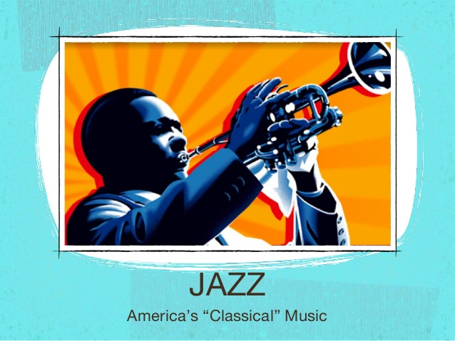
JAZZ MUSIC

Slide 2
Introduction
Jazz is a music genre that is originated from New Orleans, United States by the African Americans
Jazz became popular during 1895 between the last days of the First World War and the Great Depression
Jazz is inﬂuenced by ragtime, blues, and marching band music
Jazz is played with a lot of improvisations
Jazz represented a break from tradition music where a composer wrote an entire piece of music on paper
Jazz continued to evolve and developed into many different styles

Slide 3

Introduction

Slide 4

Brief History of Jazz Music
Americas only indigenous art form
The only music genre native to the United States
Started New Orleans, near the end of the 19th Century
Jazz music blended elements several musical cultures like Europe, America and Africa

Slide 5
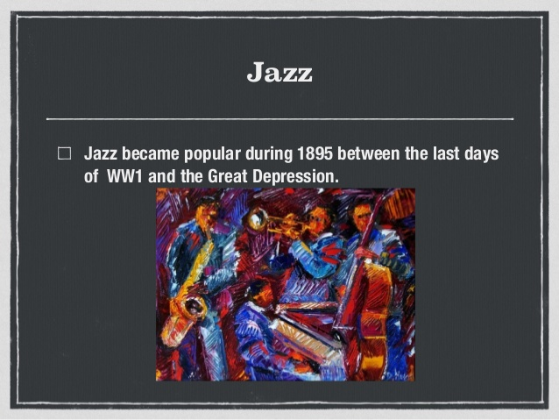
Evolution of Jazz
Jazz was just Ragtime music during about 1895
Around the 1900s, a brass band that performed for dance parties and such originated which is known as the “Classic Jazz” or the “New Orleans Style”

Slide 6
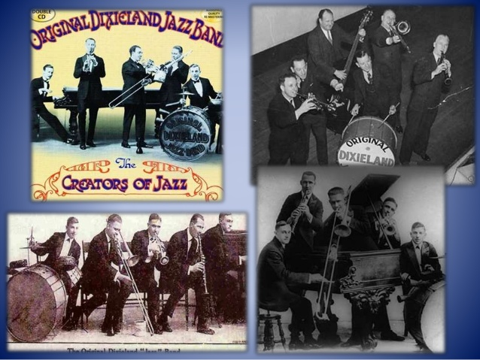
Improvisation
Jazz music is often based on improvisation since it is known as being one of the key elements

Slide 7
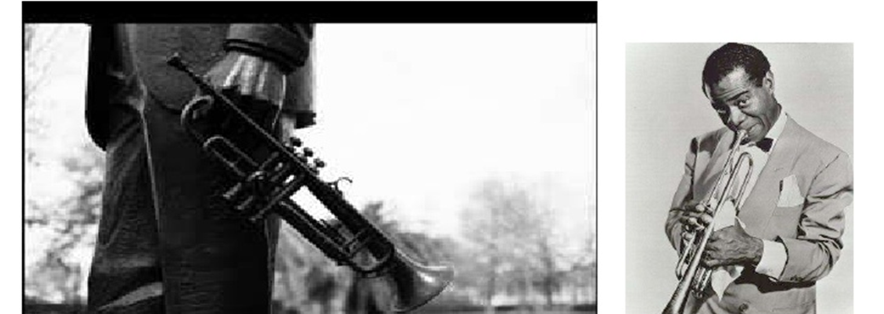
Jazz Instruments
The trumpet

Slide 8
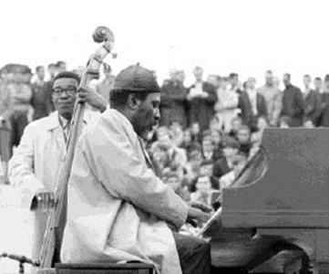
Piano

Slide 9
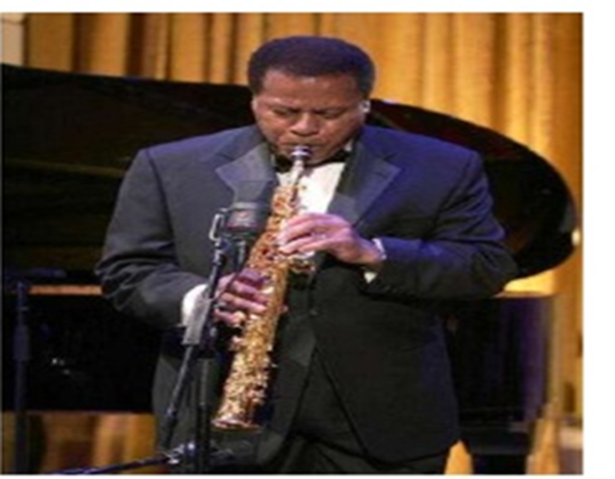
Saxophone

Slide 10

Trombone

Slide 11

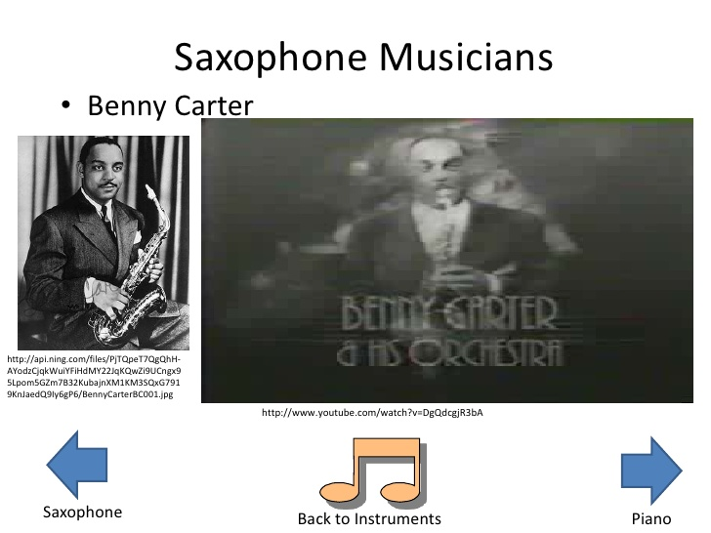
Saxophone Jazz Musician
Benny Carter

Slide 12
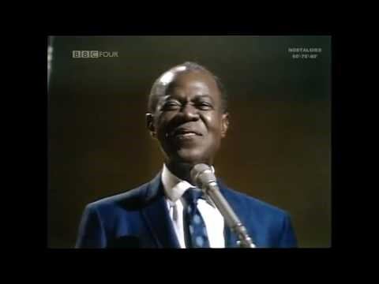
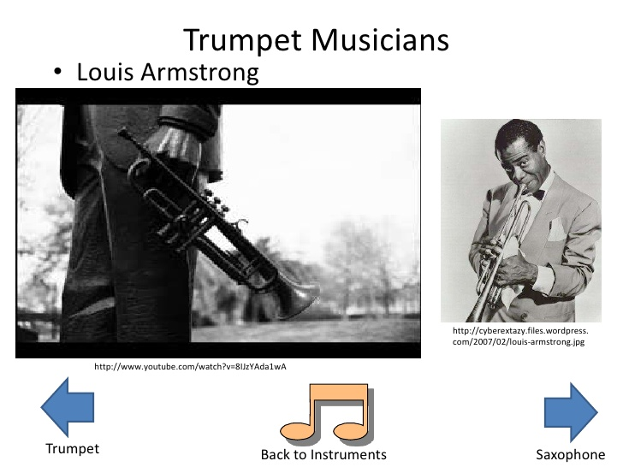
Trumpet Jazz Musician
Louis Armstrong

Slide 13
Different Styles of Jazz Music
Hot Jazz
Chicago Style
Swing
Kansas City
Gypsy Jaz
Bebop
Vocalise
Mainstream
Cool
Hard Bop
M- Base
Bossa Nova
Modal
Free & Soul Jazz
Groove
Fusion
Afro- Cuban
Post Bop
Acid Jazz
Smooth Jazz
European

Slide 14
References
Gridley, M. C., & Cutler, D. (1988). Jazz styles: History & analysis. Englewood Cliffs^ eN. JNJ: Prentice-Hall.
Hodeir, A. (1958). Jazz, its evolution and essence. Grove Press.
Zenni, S. (2016). Birth and Evolution of Jazz as Effects of Cultural Transfers. In Understanding Cultural Traits (pp. 135-143). Springer, Cham
https://www.youtube.com/watch?v=CWzrABouyeE
https://www.youtube.com/watch?v=-8oBOd_xXAU

Slide 15
THANK YOU

